Slide 1
28
Unemployment and Its Natural Rate

Slide 2

Figure 1 The Breakdown of the UK Adult Population in 2004
Employed
(28.4 million)
Labour Force
(29.8 million)
Adult
Population
(47.4 million)
Unemployed (1.4 million)
Economically inactive
(17.6 million)
Copyright©2003 Southwestern/Thomson Learning

Slide 3

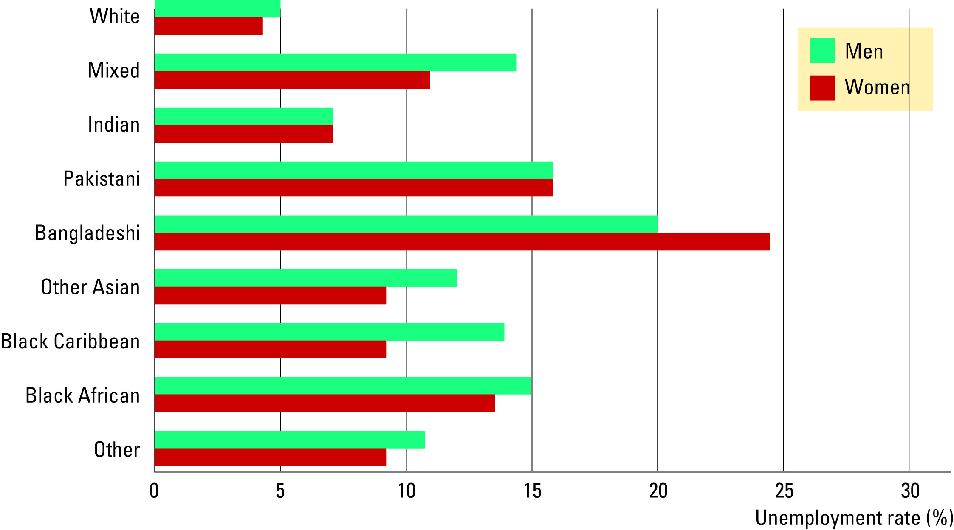
Table 1 The Labour Market Experience of Different Groups
Copyright©2004 South-Western

Slide 4
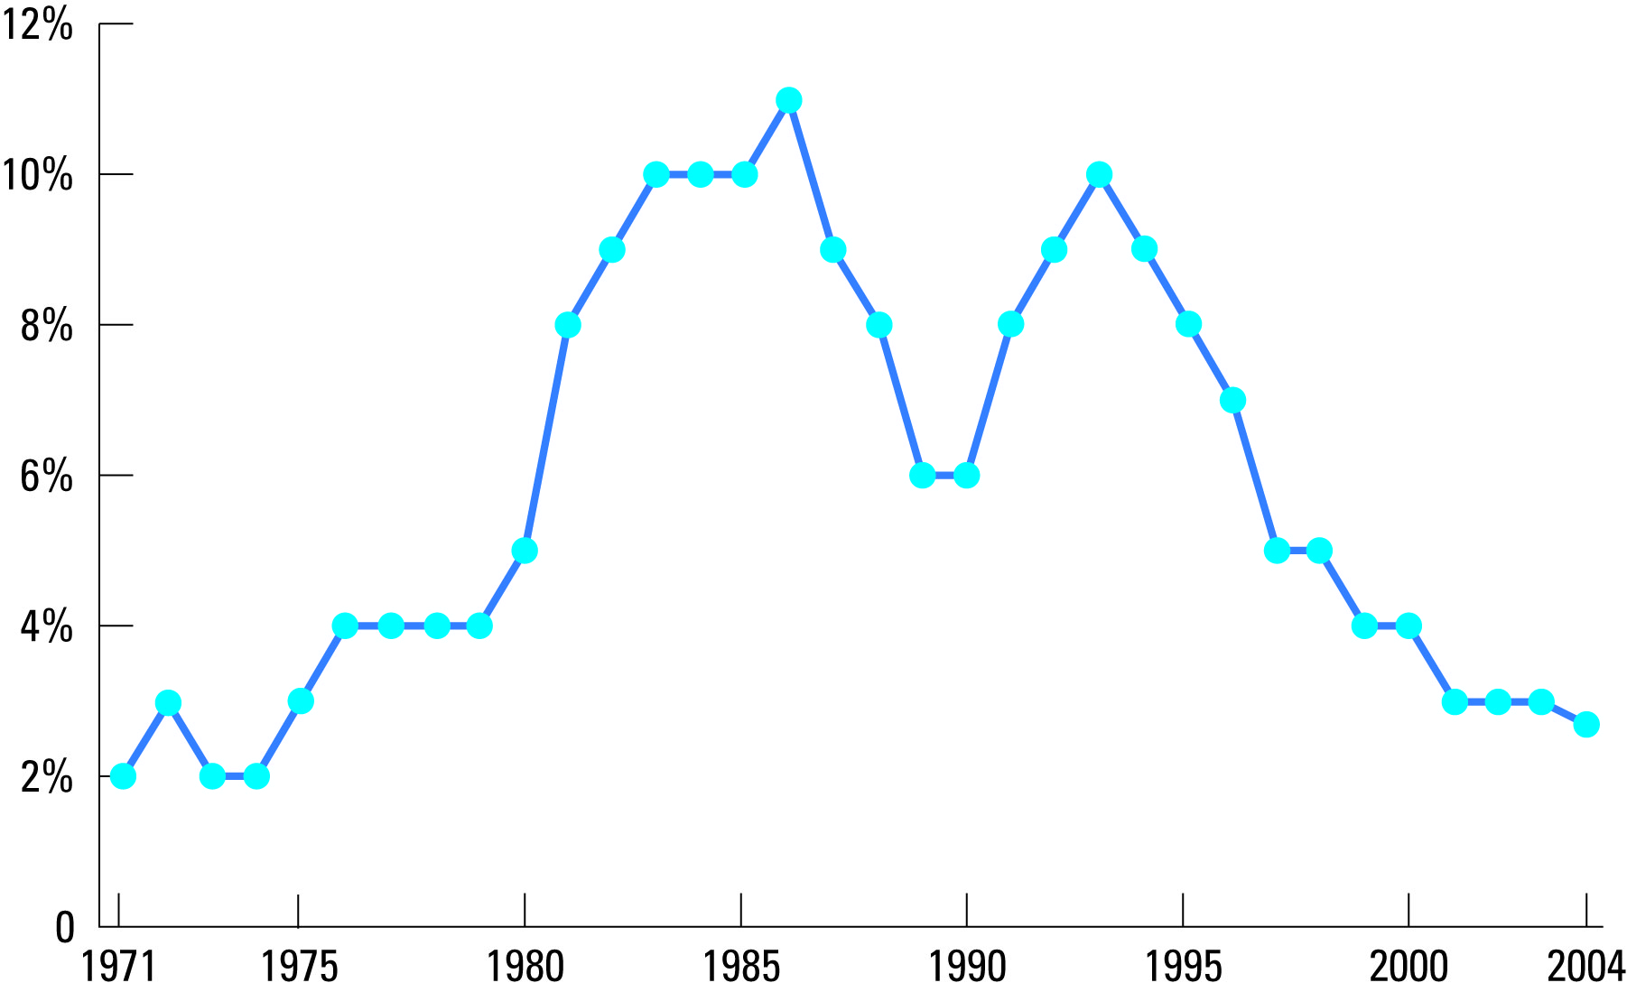
Figure 2 Unemployment Rate Since 1971
Copyright©2003 Southwestern/Thomson Learning

Slide 5
Figure 4 Unemployment from a Wage Above the Equilibrium Level
Wage
Surplus of labour
Labour
=
Unemployment
supply
Minimum
wage
W_{E}
Labour
demand
0
L_{D}
L_{E}
L_{S}
Quantity of
Labour
Copyright©2003 Southwestern/Thomson Learning

